Slide 1
ADVENTURE WORK CYCLES – Strategic Plan
IDS 521 Advanced Database Management Systems
Presented By:-
Jitendra Patel

Slide 2
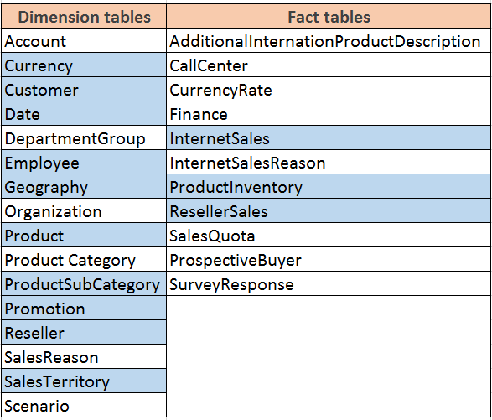
https://msdn.microsoft.com/en-us/library/hh403424

Slide 3
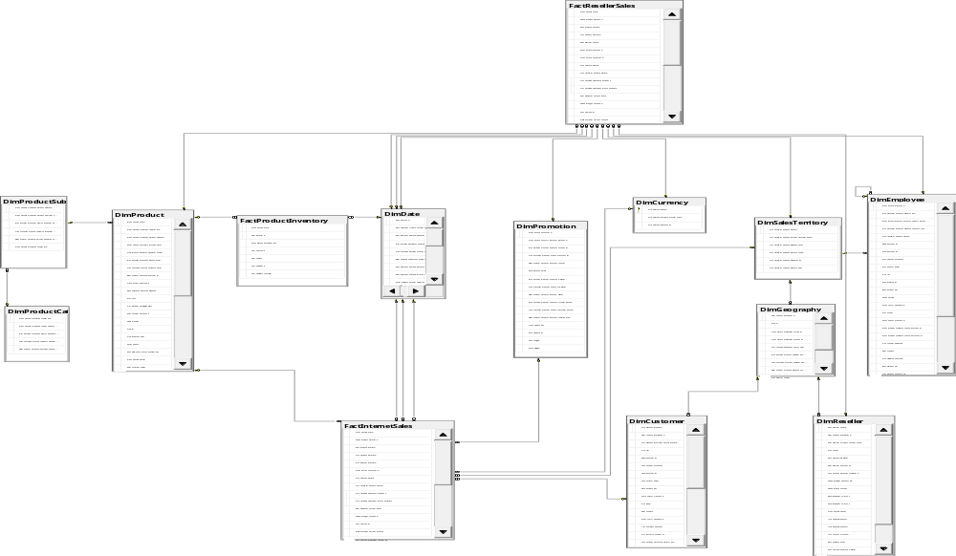
Dimensional Model

Slide 4
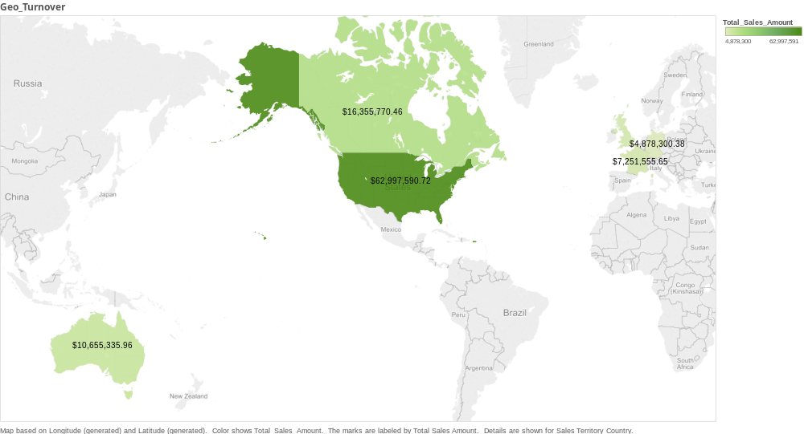
Total Sales – By Geography

Slide 5
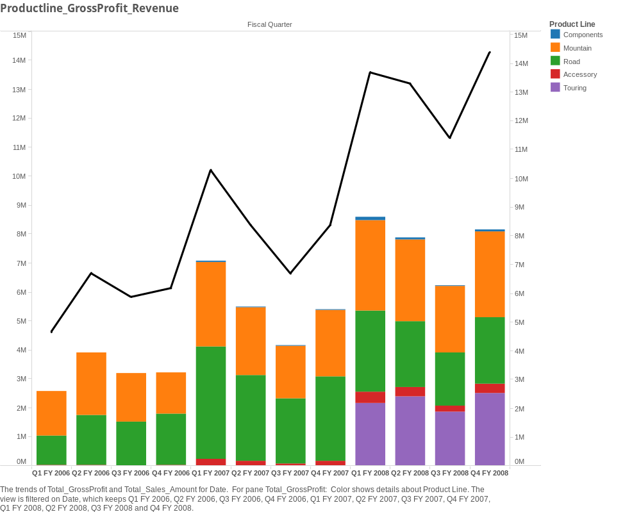
Timeline: Green line – Revenue, Bars – Profit by product line

Slide 6
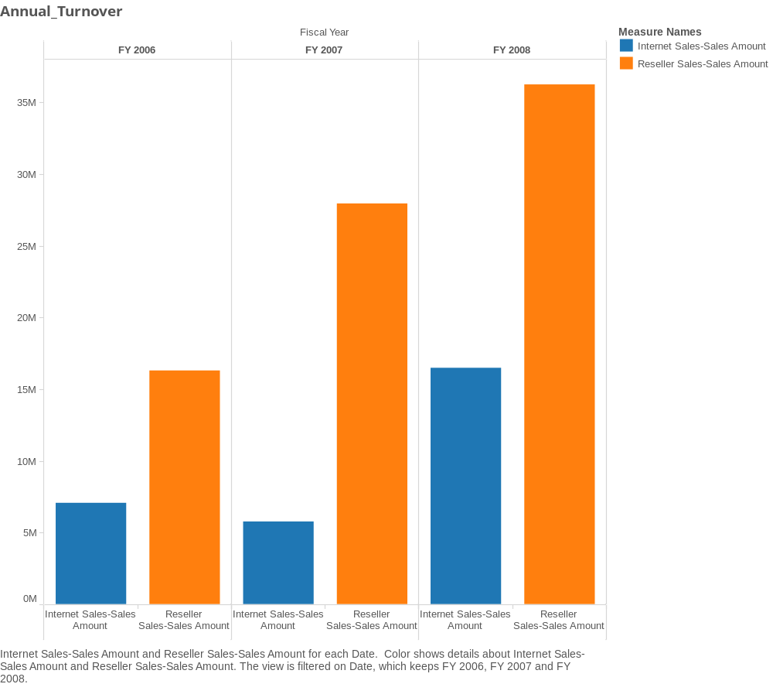
Sales Channels – Internet and Reseller

Slide 7
Internet Sales Analysis

Slide 8



Internet Sales Analysis
Internet Sales
Unintroduced Products
Low Performing Products
Identify Product Basket
Identify Product Basket
Promotions
Forecast Sales
Customer segment
Discounts
Forecast Sales
Projected Sales

Slide 9
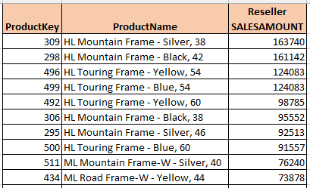
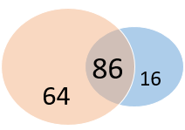

ISA – Unintroduced Products – Product basket
Products Sold
Internet
Reseller

Slide 10
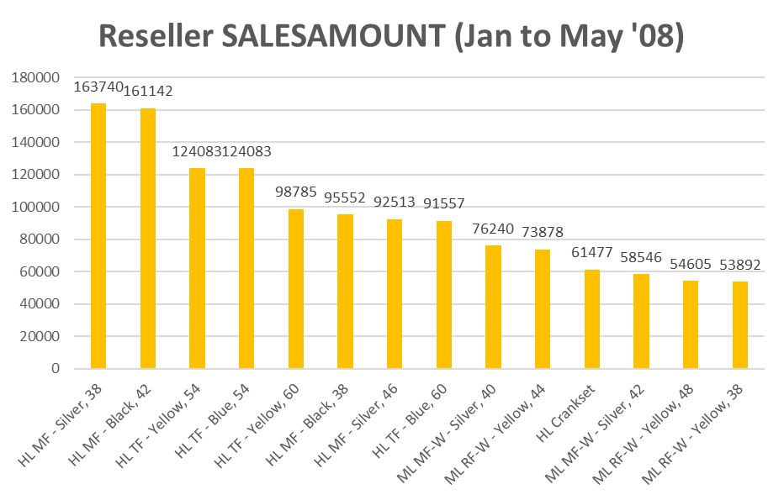
ISA – Unintroduced Products
How to arrive at Projected Sales
Use the same sales amount as Reseller sales
Use the ratio of average Reseller sales to average Internet sales
More sophisticated ways

Slide 11
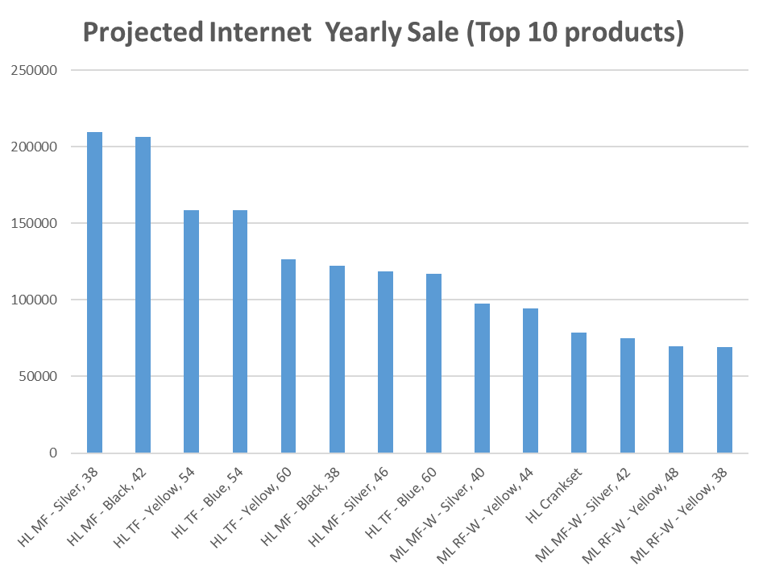
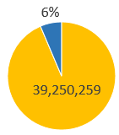
ISA – Unintroduced Products – Projected Sales
Projected Sales with New Products

Slide 12
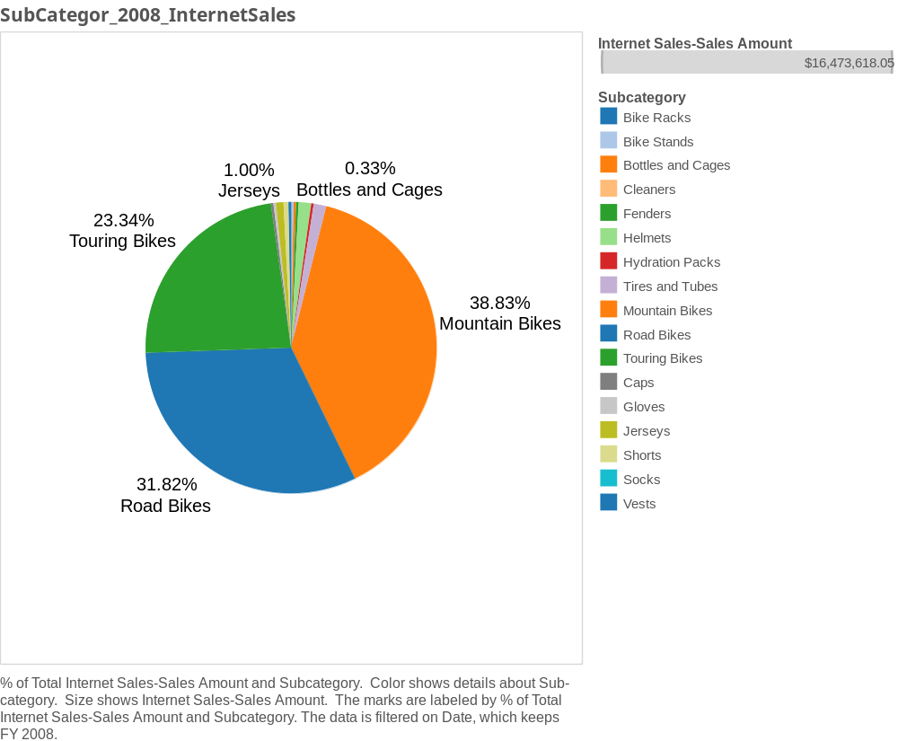
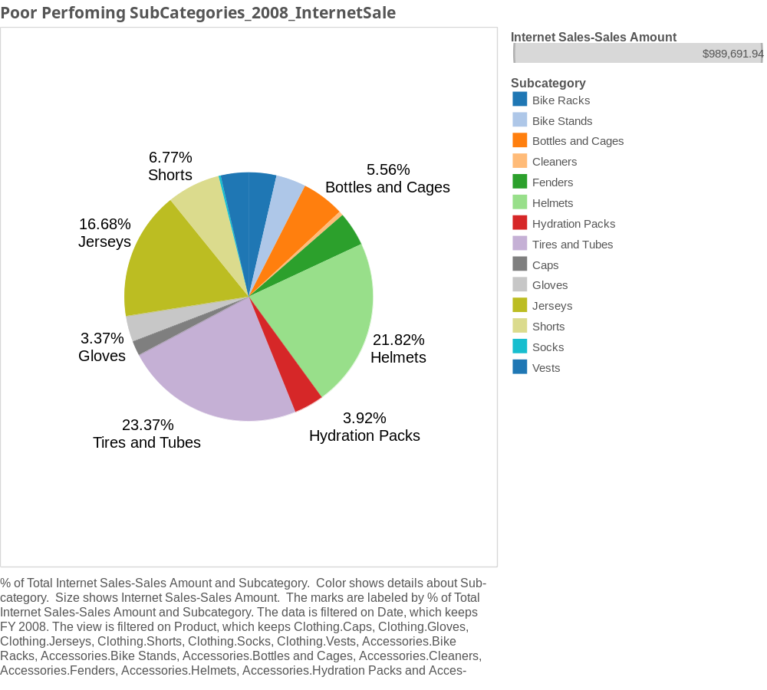
ISA – Low performance

Slide 13
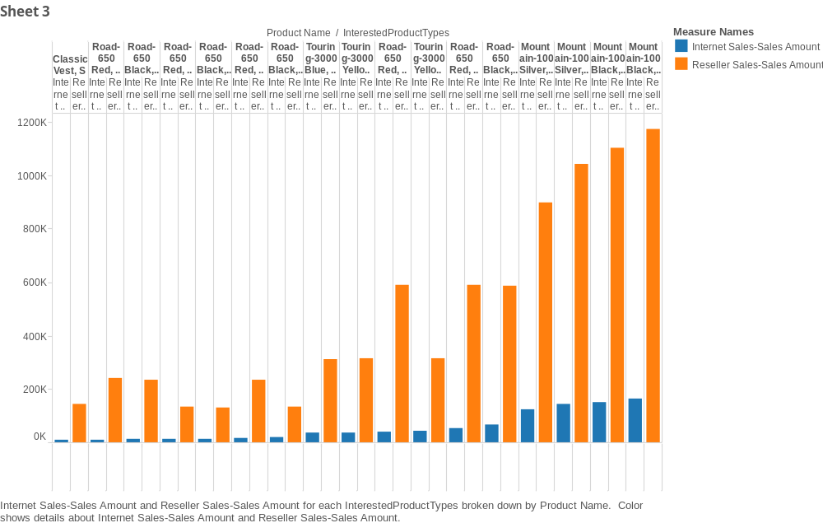
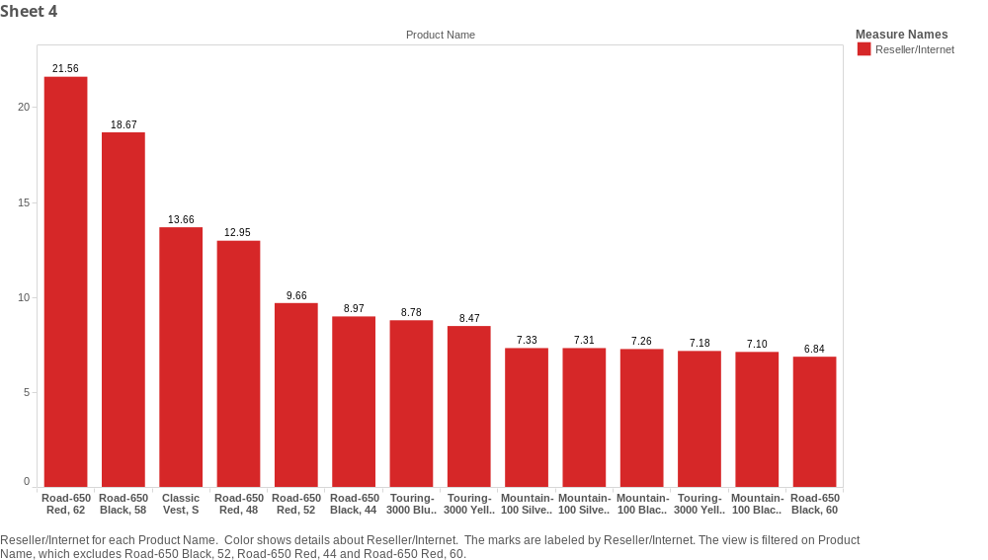
ISA– Low performance Products with Potential

Slide 14
ISA- Low performance Prod Basket
Road-650 Red, 60
Road-650 Red, 62
Road-650 Red, 44
Road-650 Black, 58
Classic Vest, S
Road-650 Red, 48
Road-650 Black, 52
Road-650 Red, 60
Road-650 Red, 52
Road-650 Black, 44
Touring-3000 Blue, 50
Touring-3000 Yellow, 62
Road-650 Red, 44
Mountain-100 Silver, 48
Mountain-100 Silver, 42
Mountain-100 Black, 42
Touring-3000 Yellow, 44
Mountain-100 Black, 38
Road-650 Black, 60

Slide 15
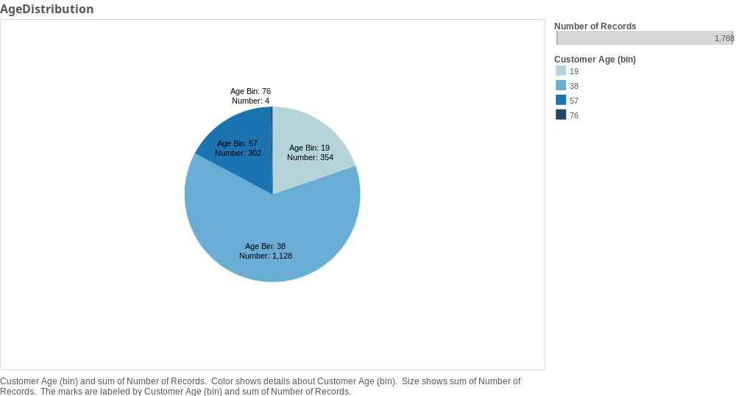
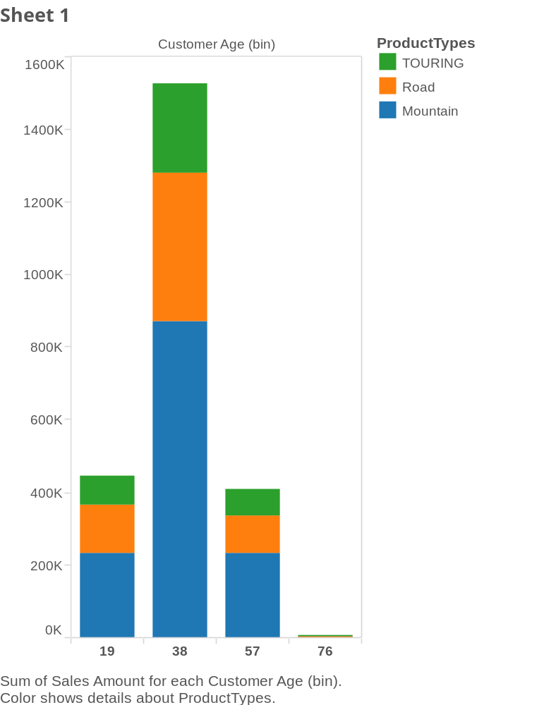
ISA – Promo Target-Customer purchases

Slide 16
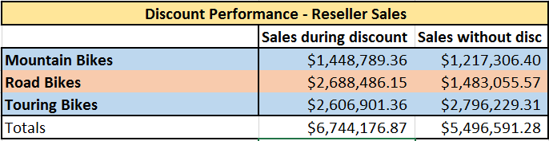

How did we arrive at avg discount of resellers

Slide 17
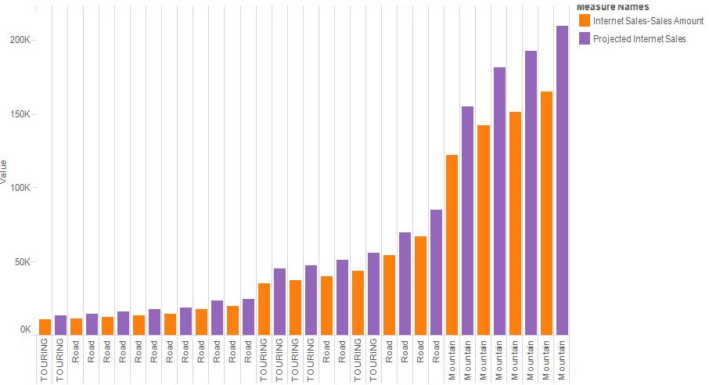
ISA– Current Vs Projected sales for targeted products

Slide 18
Reseller Sales Analysis

Slide 19


Reseller Sales Analysis
Reseller Sales
Shops with lowest revenue. Sales Amount?
Low Performing Products
Identify Product Basket
Identify Product Basket
Promotions
Discounts
Forecast Sales
Forecast Sales
Projected Sales
Identify Product basket to target
Identify ways to boost sales revenue eg: by promotions (discounts)
Forecast sales
Identify QOH shortfalls

Slide 20
Analysis on Store 4 :
ResellerKey | ProductKey
4 | 217
4 | 287
4 | 372
4 | 374
4 | 376
4 | 378
4 | 380
4 | 382
4 | 384
4 | 386
4 | 388
4 | 390
4 | 434
4 | 481
4 | 482
4 | 545
4 | 546
4 | 547
4 | 580
4 | 581
4 | 582
4 | 583
4 | 584
4 | 604
4 | 605
4 | 606
Products not sold by store 4
214
222
225
231
234
237
240
243
255
281
290
295
298
Total No of Reseller shops = 466
Total No of Products sold in 2008 = 149
No of products not sold by store 4 but sold by other stores = 123
We had analyzed the annual sales for the remaining 123 products from other reseller shops and would provide recommendation for store 4 to boost its sales revenue.
No of Products sold by store 4 = 26

Slide 21
Expected Sales raise per product for 2008
Expected Gain for a Product = Summation of Annual Sales for that product / Total no of stores
Retrieved data by grouping by product key to get the sum annual sales for each product.
Total no of stores was obtained from the Reseller dimension table .
Summation of Annual sales for product = 394900000
Total No of stores =466
Expected Gain for 1 year = (394900000/466) * (12/5)
Expected Gain if all 123 products are included = 95643605
Products not sold by store 4 | ExpectedGain
471 | 2033820
491 | 1837082
483 | 1763433
225 | 1698026
Above are the 5 recommended products with maximum expected gain for store 4

Slide 22
Recommendations
Internet sales :
provide discounts (25% - 30%)
identify the unintroduced products and make them available online
Reseller sales :
Identify underperforming resellers and introduce popular but unnoticed products (that provides better sales return for other resellers)
Other improvements
Offer product bundles
Recommender systems in online sales

